Slide 1
Trench Warfare
Creating and Analyzing Defensive Line Positions
James Hyman, Colin Krantz, Brendan McKeown, Kushal Shah

Slide 2
Table of Contents
Data
Assumptions
Defining Positions
Evaluating Player Value
Talent Distribution Across Positions
Situational Analysis
Roster Construction Analysis
Limitations and Future Analysis
Conclusion

Slide 3
Data
We grouped the data by PlayerID and summarized the various statistics to obtain a dataset with each player
We filtered this data set to include players with a snap count of greater than 50
We removed every position other than DT and DE as it would be impossible to know if those positions were playing as a part of the defensive line
We created a tackle for loss statistic for each player to add another layer to our analysis
We also used the play by play data to create matrices that we used to perform various ridge regressions
We incorporated contract data from Spotrac and team defense data from Football Outsiders to further improve our analysis

Slide 4
Assumptions
The first assumption we made was that defining defensive line positions should exclude players who are labelled as linebackers on a roster. While linebackers can play on the line in certain plays, they often end up backing up into coverage and are not as involved in the trenches as tackles and ends
When tasked with evaluating “value”, we believed that on field performance is only one facet of a player’s worth, while their salary and ability to be productive at a low cost also plays a role

Slide 5
Defining Positions
We used 2 methods to label defensive line positions based on their technique:
Hierarchical Clustering with Minimax Linkage
Random Forest Regression Analysis for Position Likelihood Values
For our labelling, rather than using a count of each technique used by a player, we used the proportion of snaps the player used that technique.
Example: Cameron Heyward lines up with a 2i Technique 14.08% of the time

Slide 6
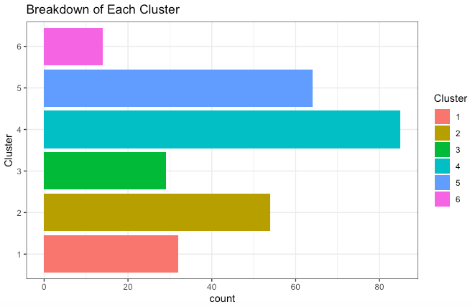
Hierarchical Clustering with Minimax Linkage
By using hierarchical clustering with minimax linkage, we grouped the players into 6 clusters. The advantage of the minimax linkage is that we can view the prototypes of each cluster for increased interpretability of the types of players in each group

Slide 7
Cluster Prototypes
Cluster 1: Aaron Donald - Typical 4-3 DT group, utilized 3 technique most often
Cluster 2: Mike Purcell - Versatile DT, playing time spread across techniques 0, 1, 2, 3 and 4i
Cluster 3: Armon Watts - A-gap DT, majority of snaps in technique 1
Cluster 4: Calais Campbell - 3-4 DE, utilized inside end techniques (3, 4, 5)
Cluster 5: Myles Garrett - Technique 7 and 9 DE, lined up outside the tackles or with the tight ends
Cluster 6: Corey Peters - Players with many snaps in 2i, a subsection of cluster 2

Slide 8
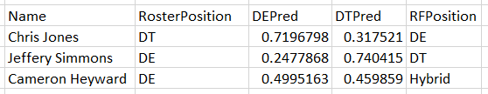
Random Forest Likelihood Values
We used a random forest regression to predict the likelihood of a player being a Defensive End or a Defensive Tackle in order to accurately label player tendencies
Players who have a similar likelihood value for being a DE and a DT were labelled as Hybrids
Example:

Slide 9
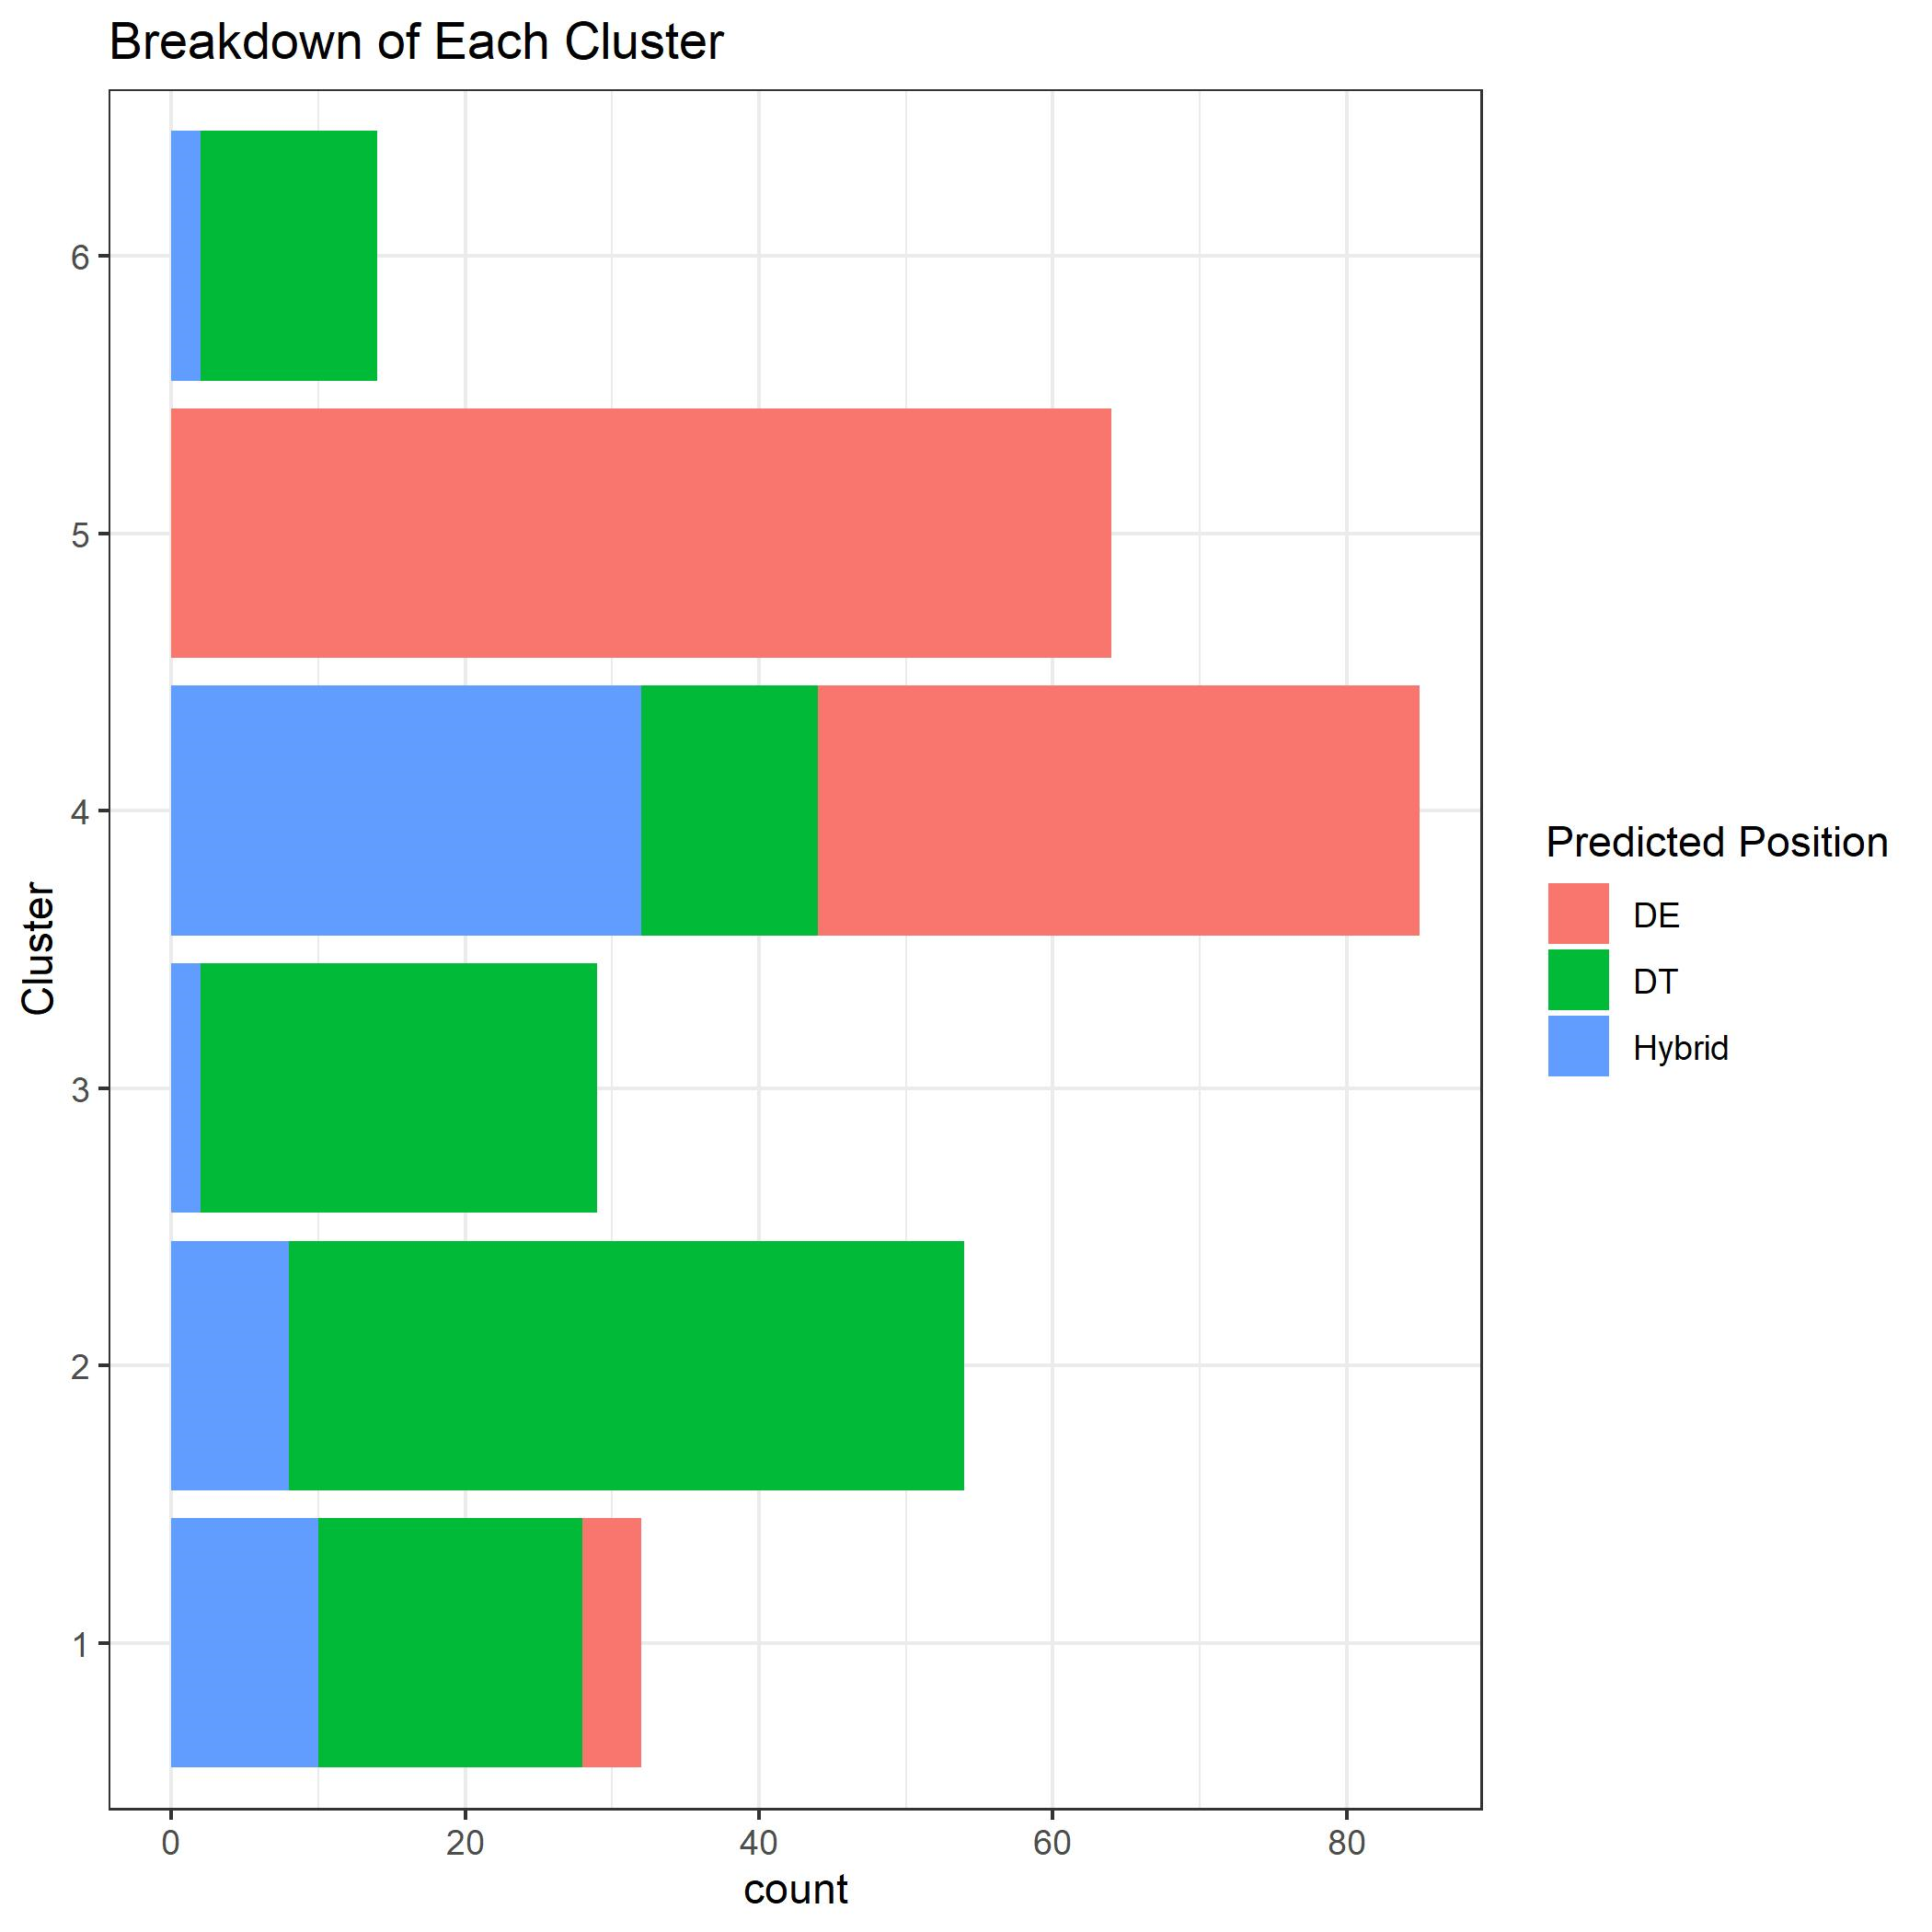
We can see each cluster and the breakdown of the predicted positions within the cluster
We used this to create position labels of players based on the cluster and predicted position
Example: A defensive end in cluster 4 would be labelled as DE_4
It is important to note that certain pairings of clusters and predicted position result in a small sample size. Hence, we cannot arrive to clear conclusions with these pairings

Slide 10
Evaluating Value
We used 4 methods to evaluate each newly defined position:
Ridge Regression
Investigating player performance adjusted for on field talent
Adjusted DVOA EPA
Using Defensive-adjusted Value Over Average to standardize player EPA
Raw Stats Rating
Weighted sum of raw stats accumulated by a player
Salary Valuation
Comparing contract valuation with a player’s on field performance

Slide 11
Ridge Regression
The benefit of using a ridge regression is that it accounts for the other players involved on the play, hence it rewards or penalizes if a player is playing with better or worse players
We ran 4 ridge regressions predicting the following statistics:
EPA
Offensive Yardage
Pressures
Sacks

Slide 12
Ridge Regression
Each ridge regression provided a coefficient that depicted how a player impacts that statistic for a play. We used a weighted sum of these coefficients to create a Ridge Rating (RR) for each player
RR = -1(Coef.EPA) – 0.75(Coef.OffensiveYardage) + 0.5(Coef.Sack) + 0.25(Coef.Pressure)
The weights here imply that a better player would have a higher ridge rating
Example:
Myles Garrett RR = -1(-0.0641) – 0.75(-0.5477) + 0.5(0.0019) + 0.25(0.0787) = 0.4955

Slide 13
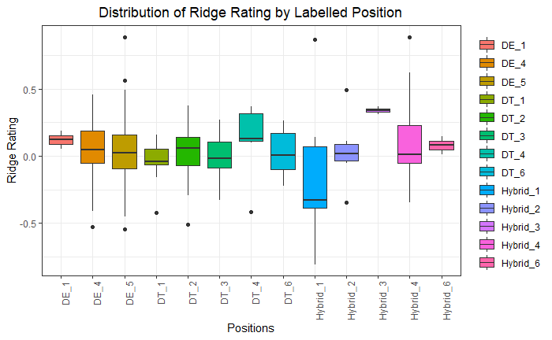

Slide 14
Distribution of Ridge Rating by Labelled Position
DT_4’s and Hybrid_3’s have the highest Ridge Ratings and includes players such Fletcher Cox and D.J. Reader
Hybrid_1’s have by far the lowest Ridge Ratings even with the significant outlier of Aaron Donald
Hybird_1’s also have the biggest distribution between their Ridge Ratings, mainly because of Aaron Donald

Slide 15
Adjusted DVOA EPA
We calculated the average EPA for each player by summing the EPA for every play they were involved in and dividing that sum by the number of plays
However, players on the same team would have extremely similar EPA values if they were playing at the same time consistently. Hence we adjusted a player’s EPA using Defensive-adjusted Value Over Average (DVOA)
DVOA is a defensive ranking metric that is based on a number of variables that accurately rank defenses in the NFL. Based on our formula, a defensive player would prefer to have a lower AdjDVOAEPA
We used the following formula for the adjustment:
AdjDVOAEPA = (1 – ScaledTeamDVOA) * PlayerEPA

Slide 16
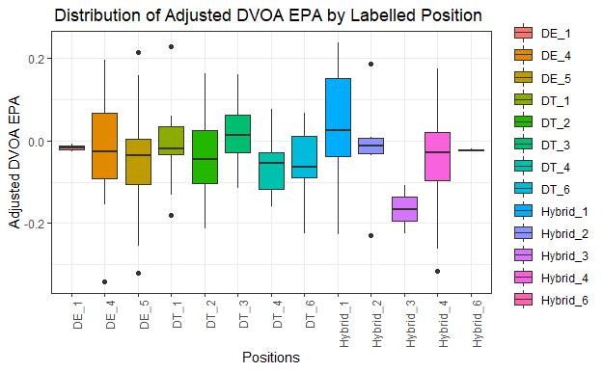

Slide 17
Distribution of Adj DVOA EPA by Labelled Position
Hybrid_3’s are clearly the best of the position groups, while DT_6’s have the best results for groups with a sample size above 5 led by Pro Bowler Kenny Clark
Hybrid_1’s remain at the bottom of the pack even with the significant outlier of Aaron Donald along with DT_3’s
Hybrid_1’s, Hybrid_4’s, and DE_5’s have the largest spreads

Slide 18
Raw Stats Rating
Instead of looking at each raw statistics individually, we decided to create a more holistic measure by using a weighted sum of various raw statistics
The raw statistics we used, in order of importance, were:
1) Forced Fumble and Interception 6) Pass Breakup
2) Solo Sack 7) Pressure
3) Assisted Sack 8) Solo Tackle
4) Solo Tackle for Loss 9) Assisted Tackle
5) Assisted Tackle for Loss

Slide 19
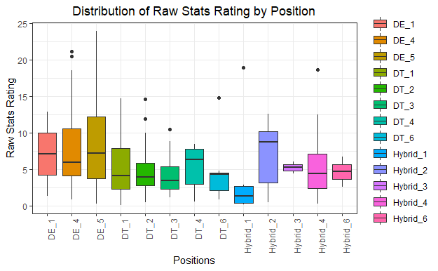

Slide 20
Distribution of Raw Stats Rating by Labelled Position
Hybrid_2’s along with DE_5’s put up the best raw stat totals
Quality Edge rushers such as Myles Garrett are part of the DE_5 group and they excel in getting pressures and sacks
Hybrid_1’s once again have the lowest median and average even with the significant outlier of Aaron Donald

Slide 21
Understanding Value
To understand which position is the most valuable, it is important to incorporate contract details into our analysis
We looked at each positions’ average salary and compared it to the 3 evaluation metrics we discussed earlier
It is important to understand that the ability of a player to produce on the field with a smaller salary makes him extremely valuable. This is because it allows a team to spend more on other aspects of the team that may need improvement

Slide 22
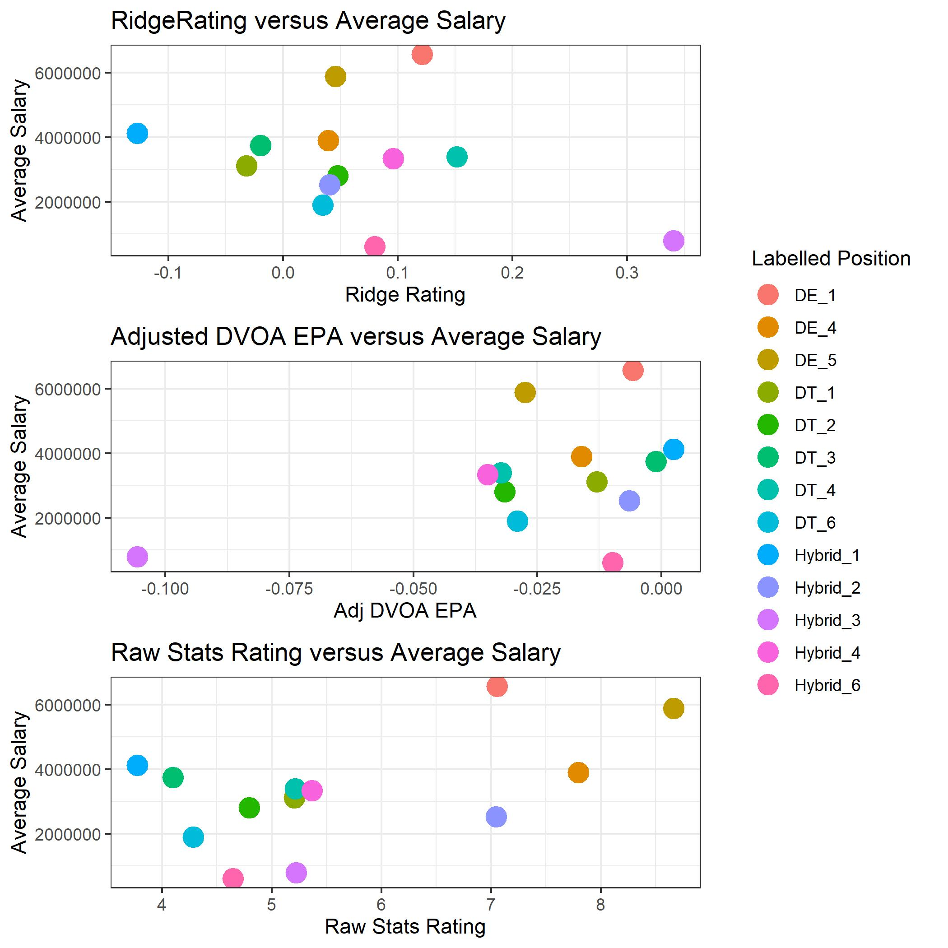

Slide 23
Interpreting Value Graphs
The most valuable positions are the ones who are paid the least but exhibit the most talented players
The most valuable position on each graph is located at:
Ridge Rating vs Average Salary: Bottom Right
Adjusted DVOA EPA vs Average Salary: Bottom Left
Raw Stats Rating vs Average Salary: Bottom Right
On the first two graphs it is clear that Hybrid_3 is the most valuable position, however, an argument can be made for both DE_4 and Hybrid_2 on the third graph

Slide 24
Summarizing our Evaluation
Our next slide shows a table that ranks every position from 1 to 13 based on our various evaluation metrics
We created a final ranking by finding the sum of each ranking. The lower the sum, the better the value of that position
We have valued on field performance slightly higher and hence have divided the ranking for Average Salary by 2
Hence, Average Salary is ranked from 0.5 to 6.5 with increments of 0.5

Slide 25
Evaluation Ranking Table
Labelled Position | Sample Size | Ridge Ranking | AdjSalary Ranking | AdjDVOAEPA Ranking | RawStatRating Ranking | Final Ranking
Hybrid_3 | 2 | 1 | 1 | 1 | 6 | 9
Hybrid_4 | 25 | 4 | 3.5 | 2 | 5 | 14.5
DT_4 | 10 | 2 | 4 | 3 | 7 | 16
DE_5 | 51 | 7 | 6 | 6 | 1 | 20
DT_2 | 40 | 6 | 2.5 | 4 | 9 | 21.5
DE_4 | 36 | 9 | 5 | 7 | 2 | 23
DE_1 | 2 | 3 | 6.5 | 11 | 3 | 23.5
Hybrid_2 | 6 | 8 | 2 | 10 | 4 | 24
Hybrid_6 | 2 | 5 | 0.5 | 9 | 10 | 24.5
DT_6 | 11 | 10 | 1.5 | 5 | 11 | 27.5
DT_1 | 14 | 12 | 3 | 8 | 8 | 31
DT_3 | 17 | 11 | 4.5 | 12 | 12 | 39.5
Hybrid_1 | 7 | 13 | 5.5 | 13 | 13 | 44.5

Slide 26
The Most Valuable Position
Based on our previous table we have determined that Hybrid_4 as the most valuable position. While Hybrid_3 has the lowest final ranking based on the previous table, the sample size is too small for us to call them the most valuable
Hybrid_4 players are extremely valuable because they have similar production to some of the better positions, but their salaries are relatively lower. The highest paid player in the Hybrid_4 group is not a part of 25 highest paid defensive linemen
While there is a decent distribution of talent in this group, as we will discuss later, the players tend to be paid below their market value making this position the most valuable.
Top Performers from Hybrid 4:
Cameron Heyward Ndamukong Suh Jonathan Allen Denico Autry

Slide 27
Talent Distribution across the Defensive Line
The next 3 slides show density plots for each of the positions in order to determine talent spread
All positions which contained a sample size of 2 were removed from the data for this part of the evaluation because of the effect of small sample sizes on standard deviation
Density plots with long tails or multiple peaks show positions with unequal distributions of talent, while more centralized plots show positions with an equal talent spread

Slide 28
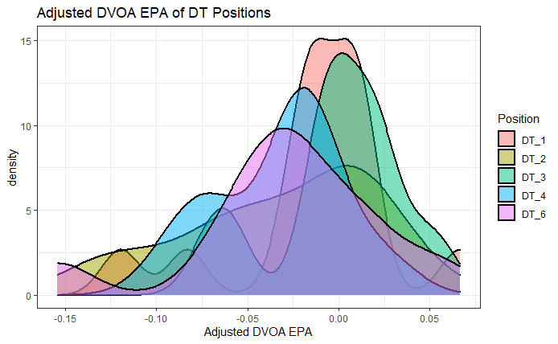
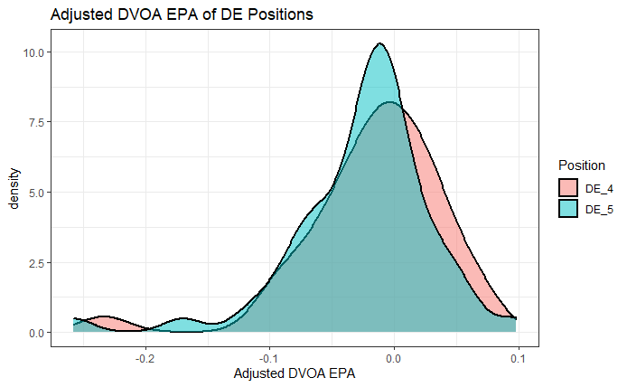
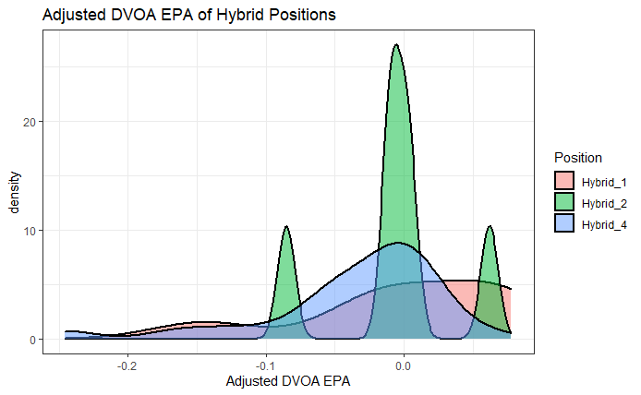
Adjusted EPA Distribution over Labelled Position

Slide 29
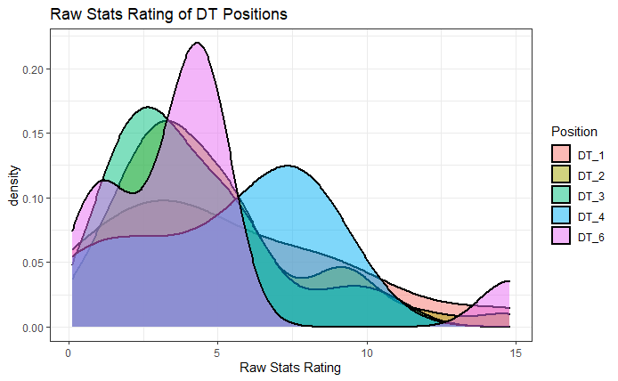
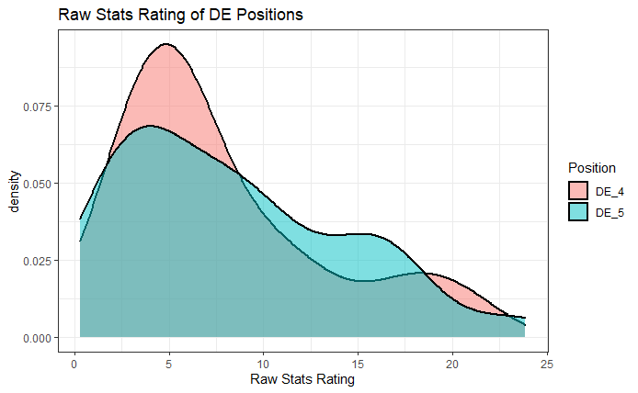
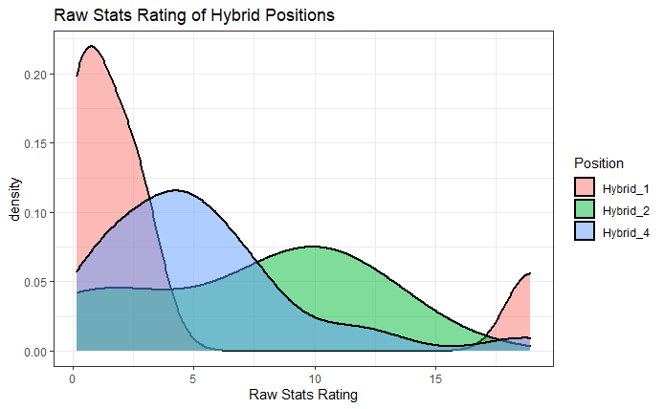
Raw Stats Rating Distribution Over Labelled Position

Slide 30
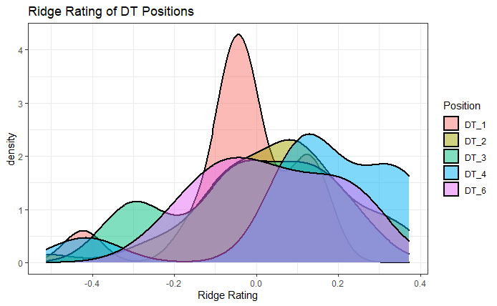
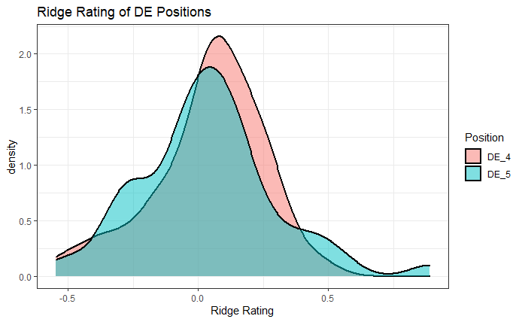
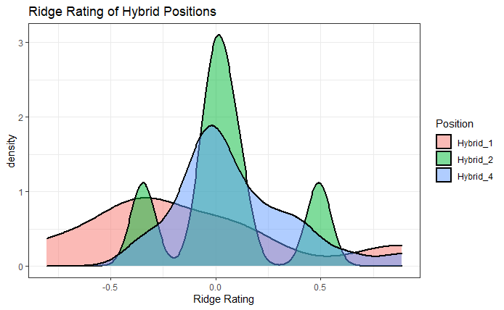
Ridge Rating Distribution over Labelled Position

Slide 31
Talent Distribution across the Defensive Line
To understand the distribution of talent we analyzed the standard deviation
Our next slide shows a table that ranks every position from 1 to 13 based on our various evaluation metrics in terms of standard deviation (from least to most deviated)
Since we are looking at talent and not value, we did not incorporate a salary component for this analysis
The final standard deviation ranking was created by taking the average ranking of the standard deviations for each evaluation metric
Example: Hybrid_6
Adjusted DVOA EPA Rank: 1; Raw Stats Rating Rank: 3; Ridge Rating Rank: 3
Standard Deviation Rank = (1 + 1 + 3)/3 = 2.3333

Slide 32
Standard Deviation Ranking Table
Labelled Position | Sample Size | Adj DVOA EPA Standard Deviation | Raw Stats Rating Standard Deviation | Ridge Rating Standard Deviation | Standard Deviation Rank
Hybrid_6 | 2 | 0.0021 | 2.9212 | 0.0978 | 2.3333
Hybrid_3 | 2 | 0.0619 | 1.1711 | 0.0390 | 4.3333
DT_3 | 17 | 0.0356 | 2.6114 | 0.1867 | 4.3333
DT_1 | 14 | 0.0443 | 4.0685 | 0.1452 | 5.3333
DT_4 | 10 | 0.0347 | 3.0731 | 0.2283 | 5.3333
DE_1 | 2 | 0.0040 | 8.1405 | 0.0923 | 5.6667
DT_2 | 40 | 0.0525 | 3.1516 | 0.1821 | 6
DT_6 | 11 | 0.0538 | 3.8154 | 0.1610 | 6.3333
Hybrid_2 | 6 | 0.0471 | 4.9487 | 0.2707 | 8.6667
DE_4 | 36 | 0.0565 | 5.5285 | 0.2138 | 9
DE_5 | 51 | 0.0572 | 5.9357 | 0.2624 | 10.3333
Hybrid_4 | 25 | 0.0653 | 4.0914 | 0.2835 | 10.6667
Hybrid_1 | 7 | 0.0770 | 6.7608 | 0.5357 | 12.6667

Slide 33
Talent Distribution across the Defensive Line
As we can see from the density plots and standard deviation rankings, positions with a reasonable sample size and equal talent distributions are:
DT_3
DT_1
DT_4
On the other hand, positions which have unequal distributions of talent are:
Hybrid_1: Aaron Donald is in this group
Hybrid_4: High levels of talent like Cameron Heyward and Ndamukong Suh vs lower levels of talent like Renell Wren and Michael Bogbe
DE_5: Edge rushers on the field for passing downs can lead to either big production or heavy losses in the passing game

Slide 34
Situational Analysis
We looked at the following different game situation:
Running plays versus passing plays
The first two downs versus third down
The first three quarters versus the fourth quarter
We focused on the Raw Stats Rating as a dependent variable for comparing the positions during different game situations because it performed the best out of our models in terms of accurately giving higher scores to players who are perceived to be superior

Slide 35
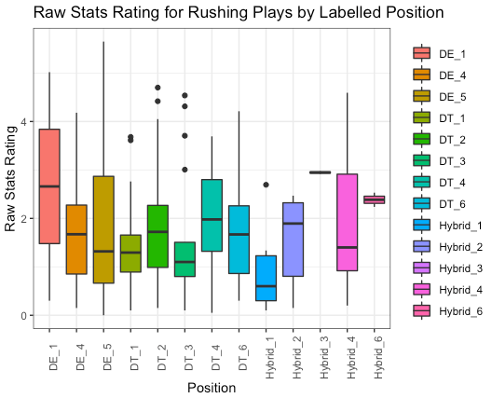
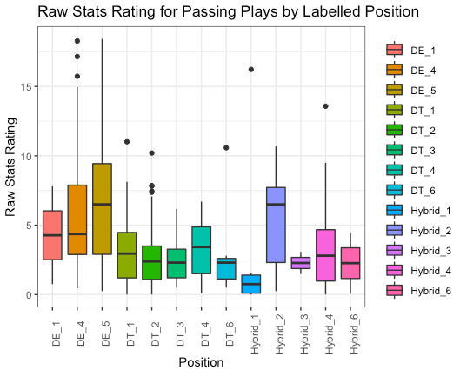
Run versus Pass

Slide 36
Run versus Pass
There are two main differences between the run and pass play only graphs. The overall rating of every cluster drops dramatically for run plays because there are less opportunities to acquire the game statistics used to calculate the model
Moreover, the random forest defined defensive tackle clusters saw a major hit to their ratings in comparison to their defensive end and hybrid counterparts. This is most likely due to the relative importance of tackles to stop the run versus to get to the quarterback. There are also less tackles playing in obvious passing situations
Overall, DT_4 has the highest average rating for rushing plays while DE_5 and Hybrid_2 top the charts for passing plays

Slide 37
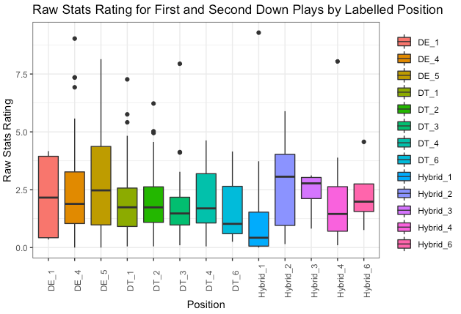
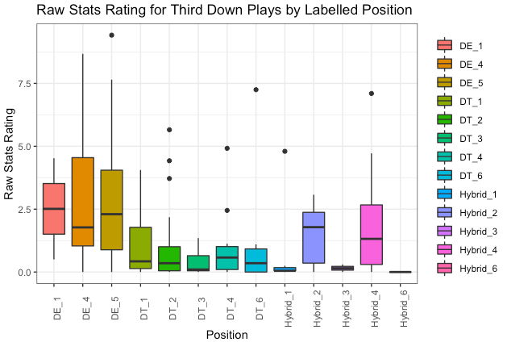
Downs

Slide 38
Early versus Late Downs
The conventional strategy of less tackles and more defensive ends on third down leads to the split seen in the previous graphs
While no position drastically increases their rating on third down, the ends and some hybrid groups stay relatively even while the defensive tackle assigned groups provide little production in this situation

Slide 39
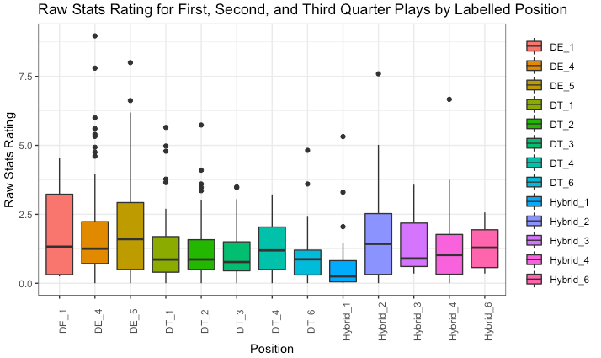
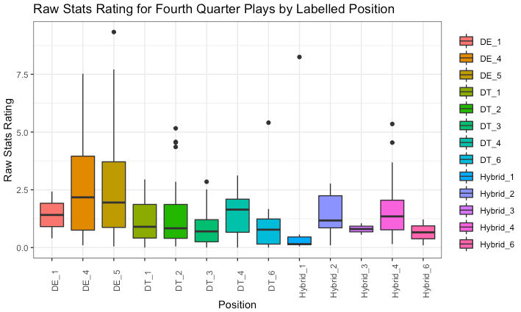
Quarters

Slide 40
Beginning versus End Game
The fourth quarter saw relatively little change compared to the first three segments of the game
While defensive tackles stayed constant, DE_4 and DE_5 saw a noticeable increase in their scores later in games
This discrepancy may be attributed to the riskier offensive plays late in games which lead to more sacks and tackles for loss

Slide 41
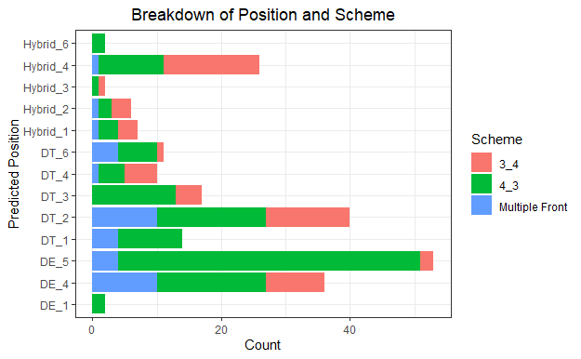
Roster Construction Analysis
To understand the impact of different roster construction scenarios we looked at a breakdown of each position and which defensive schemes they were a part of
We can see that the DE position groups have a majority of their players play as a part of a 4-3 scheme
DT and Hybrid groups are spread more evenly across the different defensive schemes

Slide 42
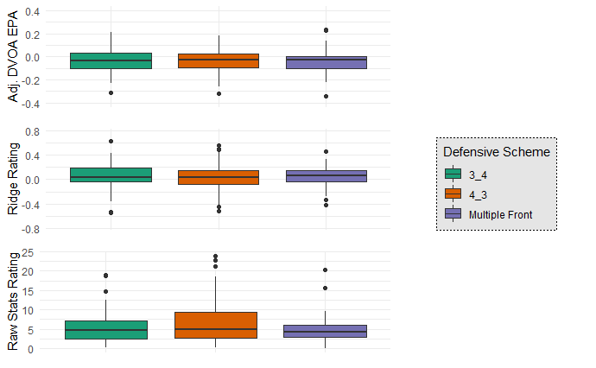
Defensive scheme did not play a huge part in the variation of performance metrics we used for our evaluation
This could be because the defensive linemen getting the most snaps are put in a scheme that best utilizes their skill sets

Slide 43
Limitations and Future Analysis
The data we had access to only had 9 weeks of data which limits our analysis. A full season's worth of data would allow us to create more accurate position labels for players. This would most likely eliminate position groups with low sample sizes.
A full season’s data would also allows to be more accurate with ridge regressions. The ridge regression would also largely benefit with data for offensive players (OL specifically) as we could then account for the offense’s talent level.
For the future, we hope to look at the impact pre-snap motions and different offensive formations would have on the performance of our newly defined positions

Slide 44
Conclusion
We determined that players in the Hybrid_4 group were the most valuable
The players in the Hybrid_1 group had the most unequal distribution of talent and players in the DT_3 group had the most equal distribution of talent.
Game situations such as 3rd down and passing plays lead to a performance drop off for defensive tackles while defensive ends increased their production in the 4th quarter compared to the rest of the game.
We concluded that defensive schemes tend to not see major impacts on the performance as players are selected for a scheme to best use their skill set.

Slide 45
References
https://www.idpguru.com/2019/02/2019-defensive-coordinators-and-schemes.html
https://www.footballoutsiders.com/dvoa-ratings/2019/final-2019-dvoa-ratings
https://www.spotrac.com/nfl

